Slide 1
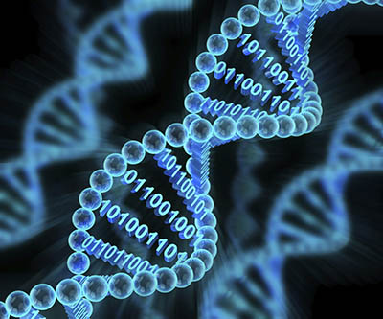
Genomic Data Visualization
Group Members: Anna Mengjie Yu
Syed Naqvi
Duy Vu

Slide 2
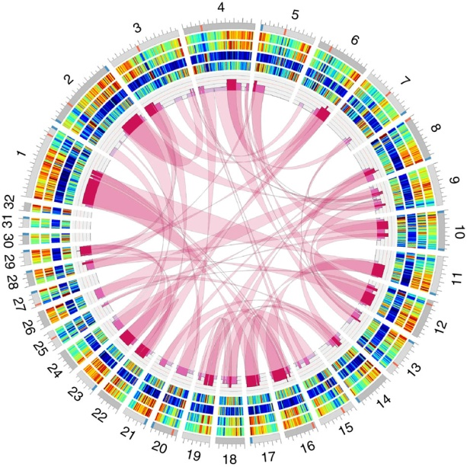
Outline
Data Source 1 Visualization
Current Genome Sequencing and future trend
Data Source 2 Visualization
Animal Genome Sizes
Data Source 3 Visualization
Diatom Plastid Genomes

Slide 3
Outline
Data Source 1 Visualization
Current Genome Sequencing and future trend
Data Source 2 Visualization
Animal Genome Sizes
Data Source 3 Visualization
Diatom Plastid Genomes

Slide 4
Data Source 1

Slide 5
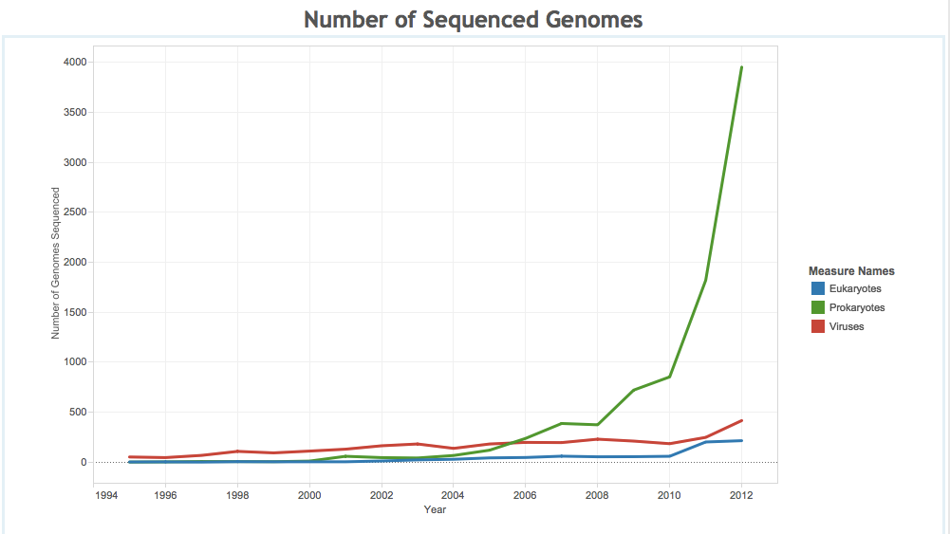

Slide 6
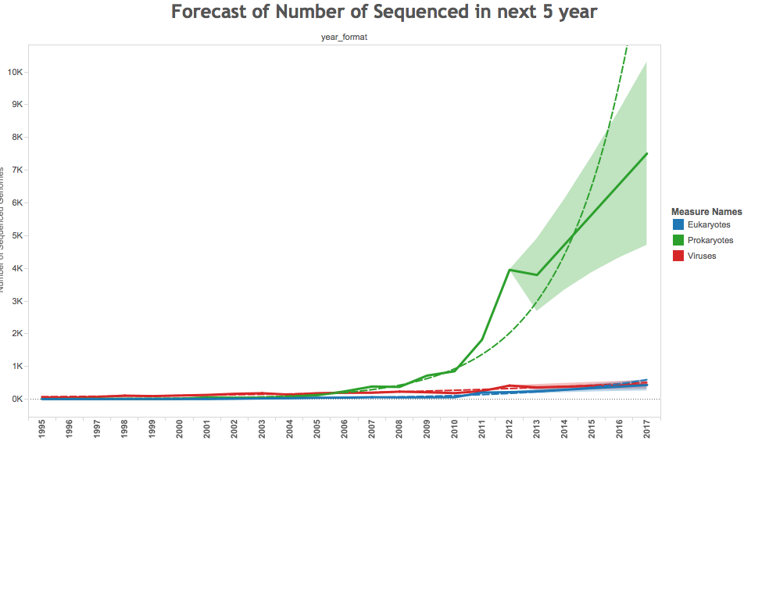

Slide 8
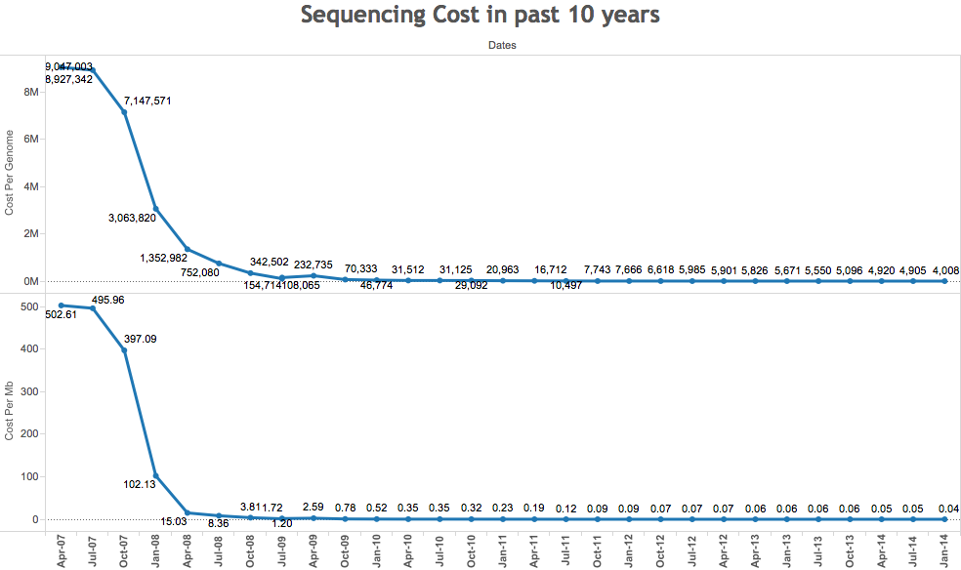

Slide 9
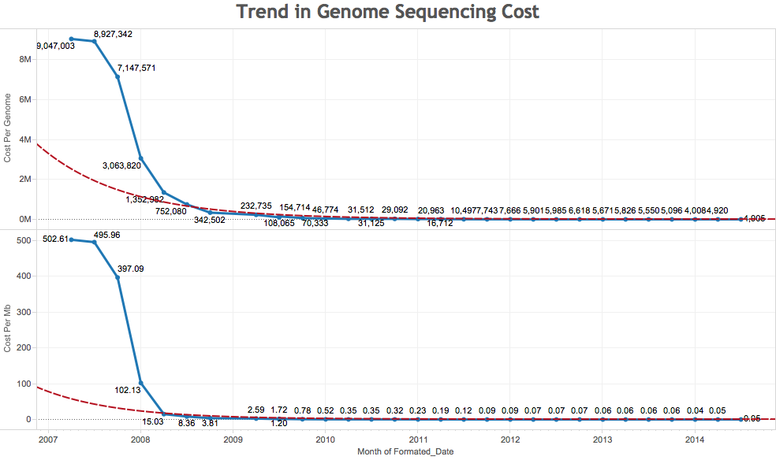

Slide 10
Outline
Data Source 1 Visualization
Current Genome Sequencing and future trend
Data Source 2 Visualization
Animal Genome Sizes
Data Source 3 Visualization
Diatom Plastid Genomes

Slide 11
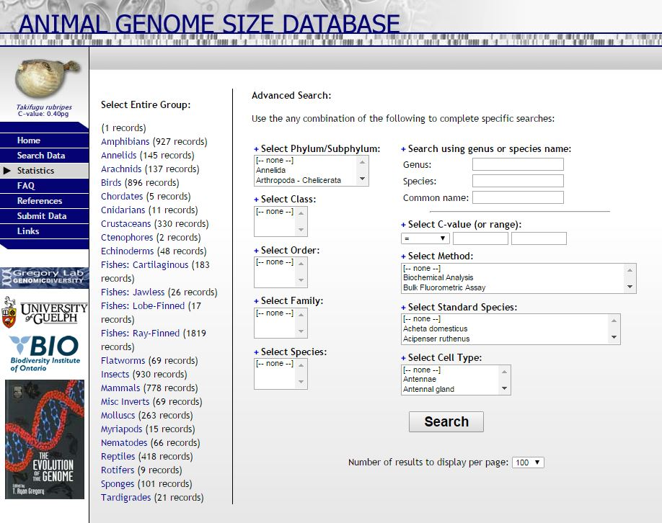
Data Source 2

Slide 12
Data Source 2

Slide 13
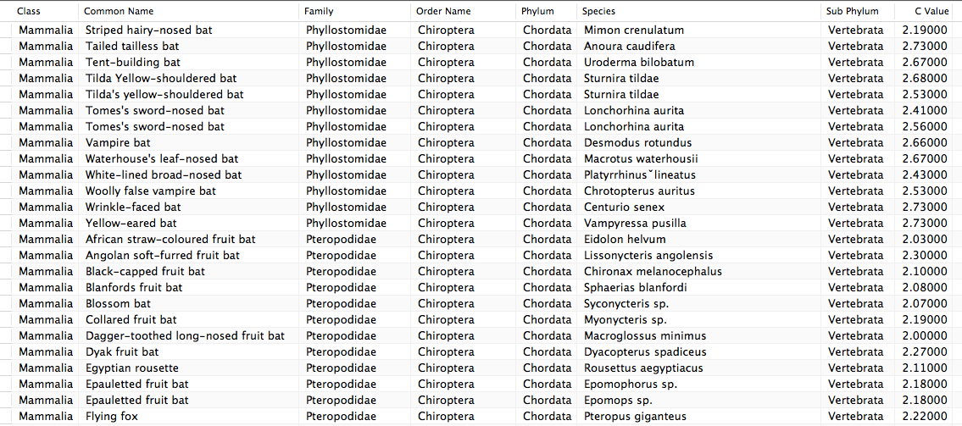

Slide 14
C Value: the amount of DNA contained within a nucleus ( in picograms).

Slide 15
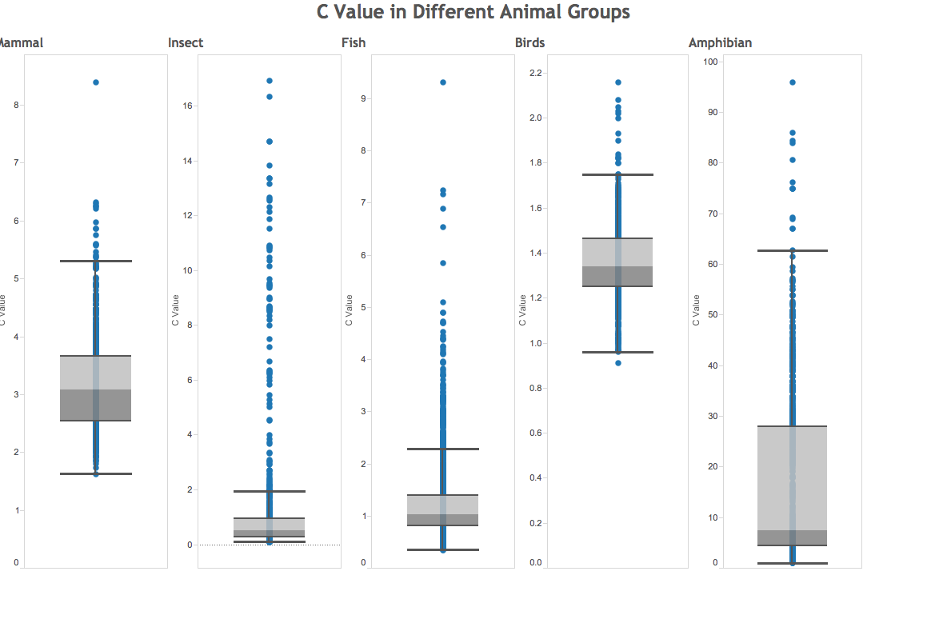

Slide 16
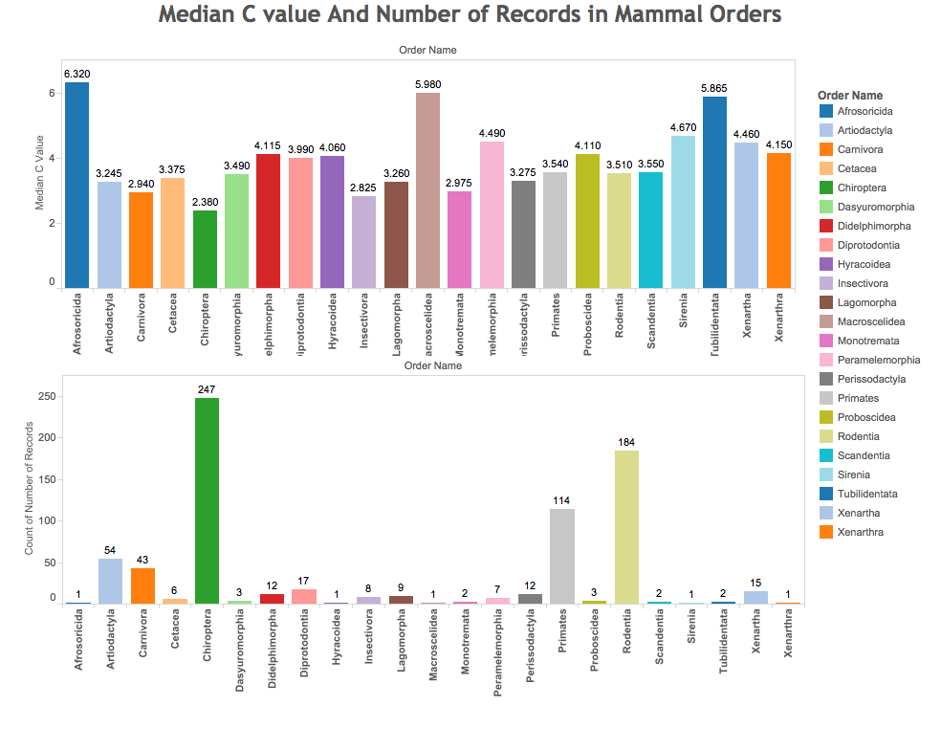

Slide 17
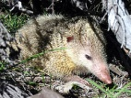
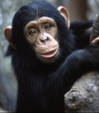
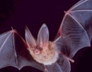

Slide 18
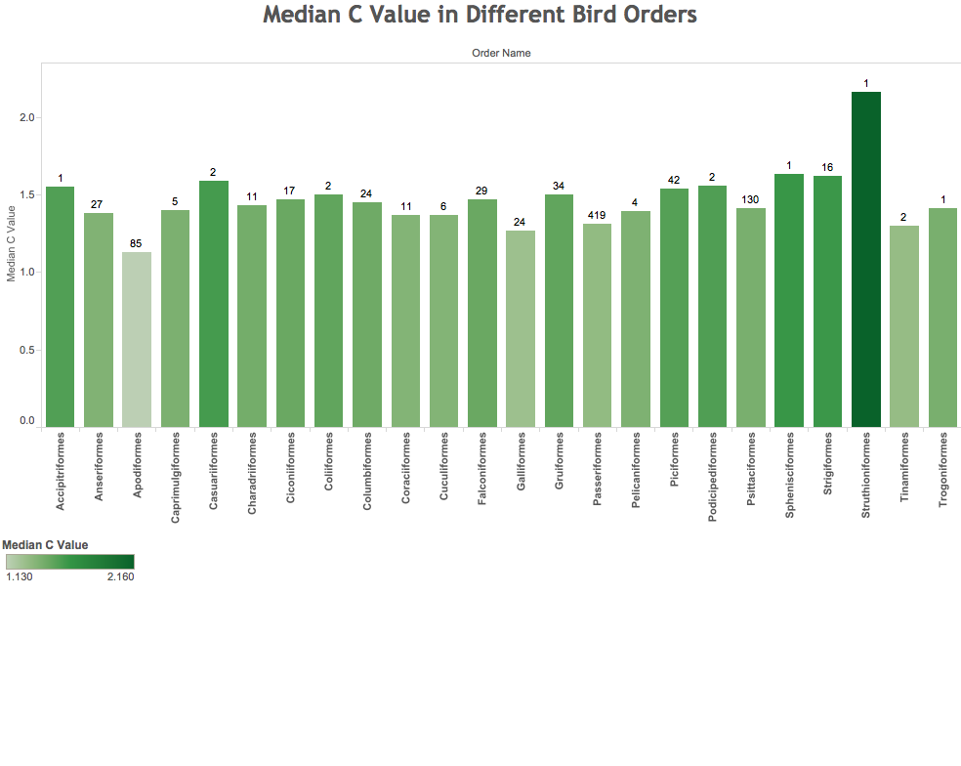

Slide 19
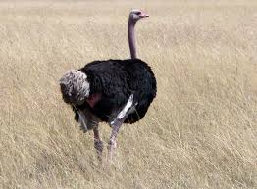


Slide 20
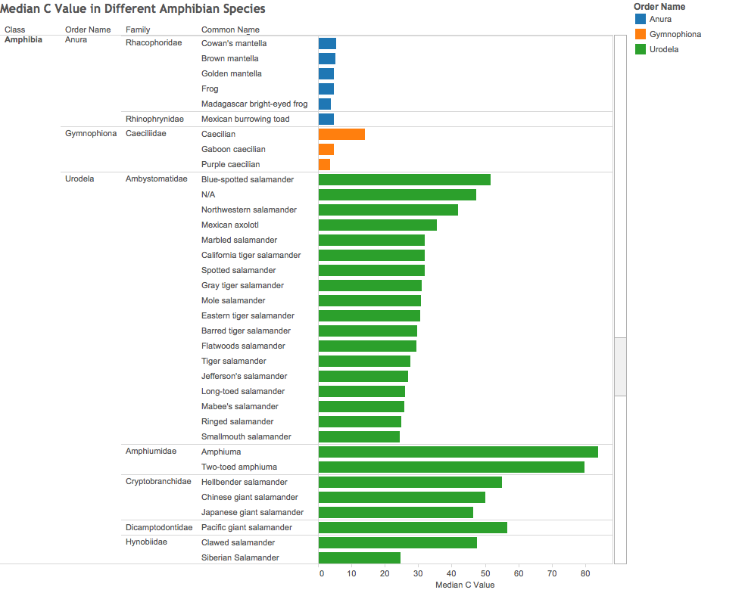

Slide 21
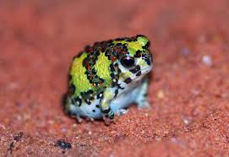
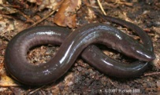

Slide 22
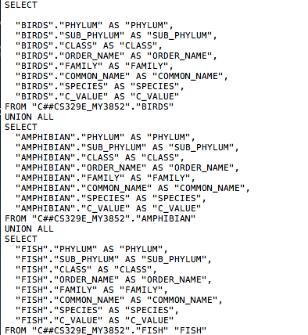

Slide 23
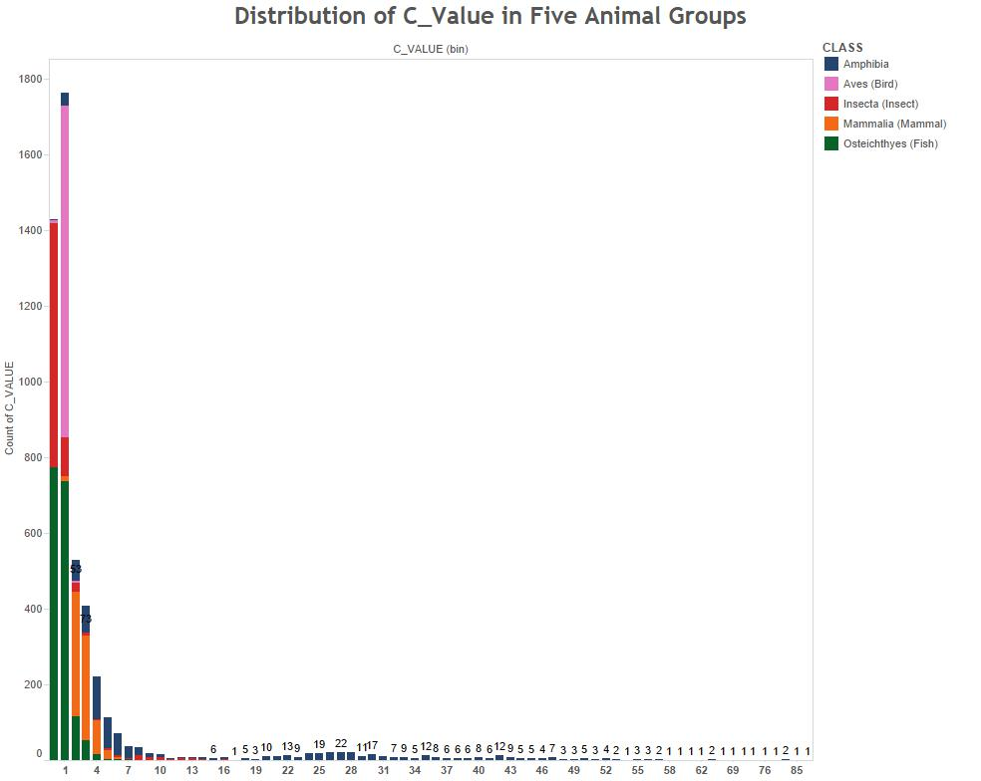

Slide 24
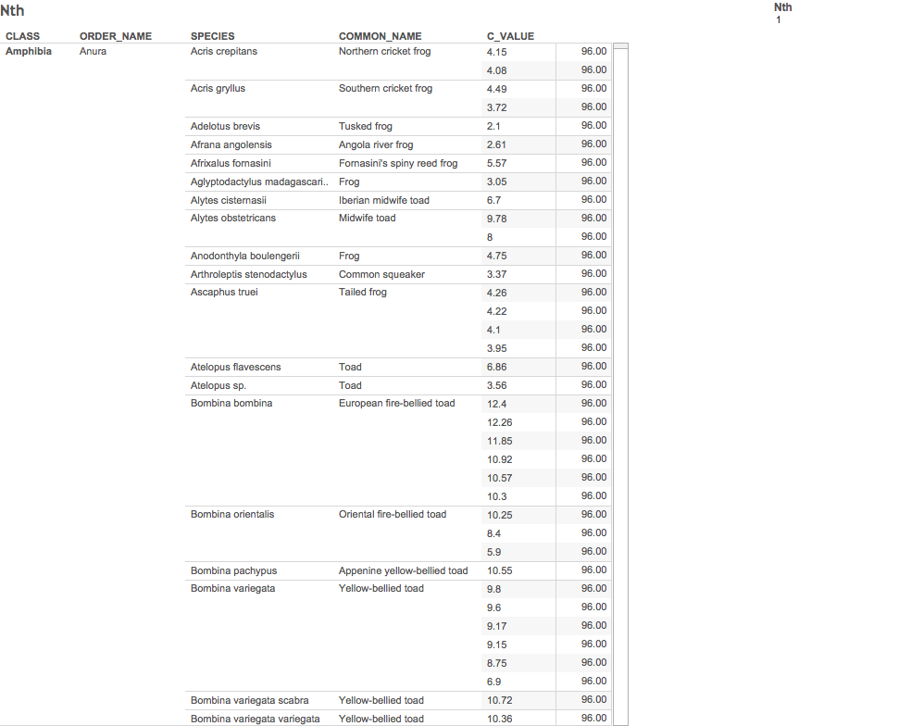

Slide 25


Slide 26
Outline
Data Source 1 Visualization
Current Genome Sequencing and future trend
Data Source 2 Visualization
Animal Genome Sizes
Data Source 3 Visualization
Diatom Plastid Genomes

Slide 27
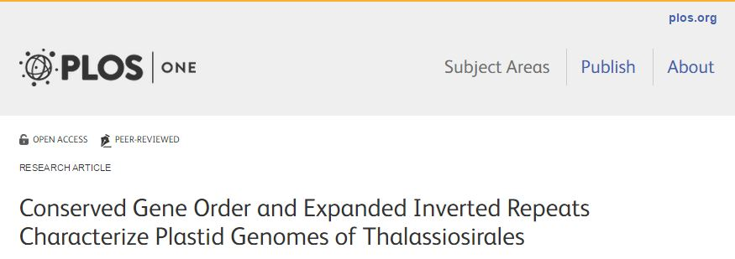
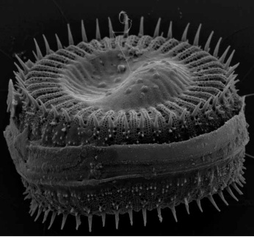
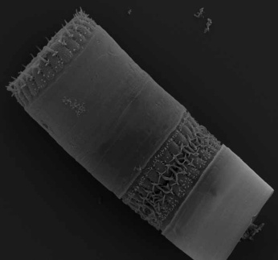
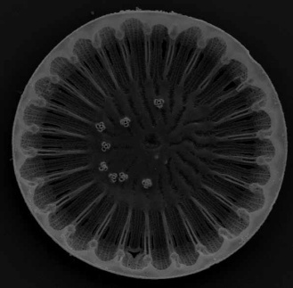
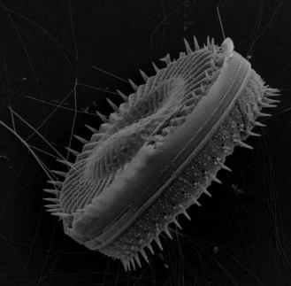
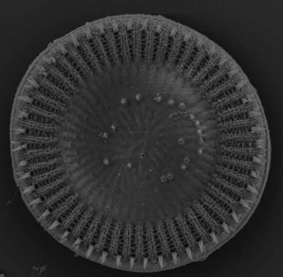
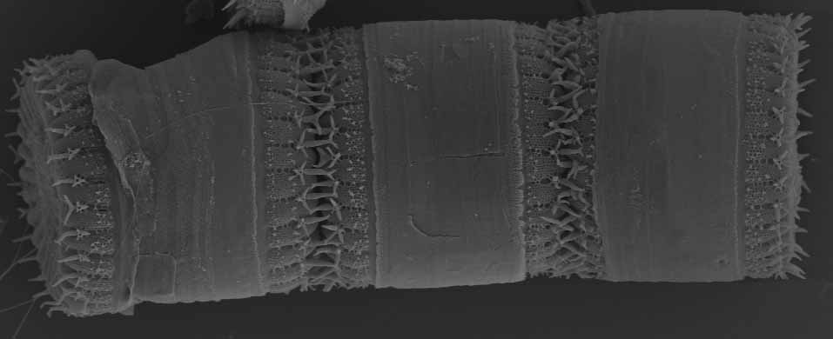
Data Source 3

Slide 28
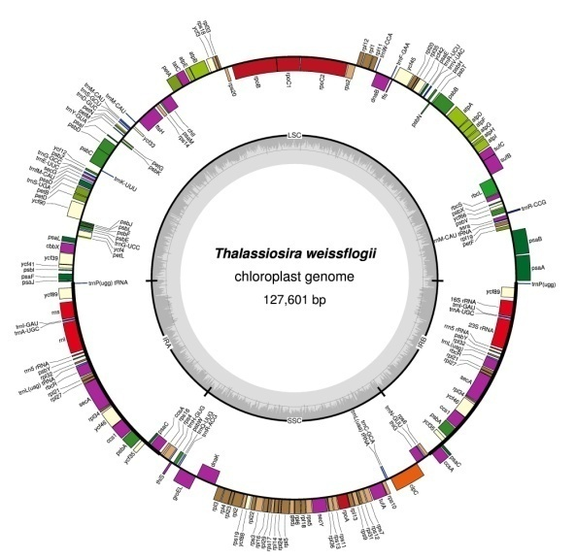

Slide 30
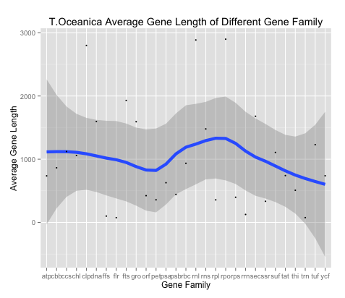

Slide 31
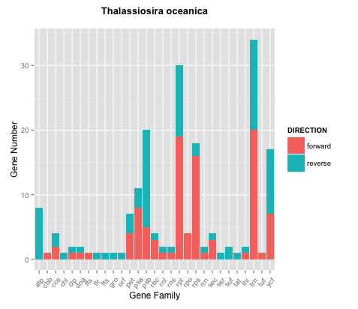

Slide 32
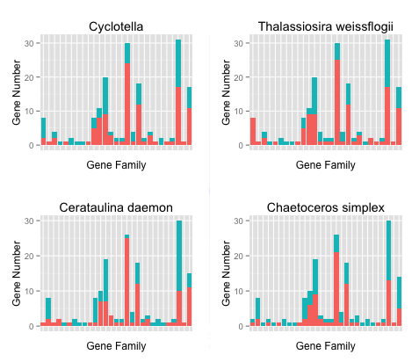

Slide 33
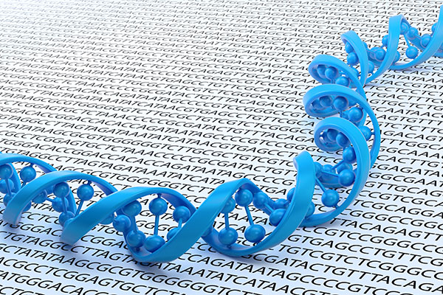

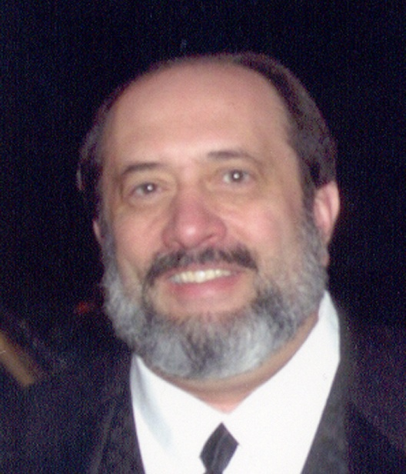
Thank you!
R + Tableau

